Slide 1
Diabetes Analysis And Prediction
By: Atman Mishra
Team Name: Lone Wolf

Slide 2
Project analysis slide 2
Data Collection
Data Validation
Finding correlation
Data Cleaning
Data
Preparation
Analyzing the problem
Building model
Training the model
Testing the model
Selecting Features
Choosing algorithm
Steps for Data Analysis
Repeat if desired accuracy is not achieved
Choosing different algorithm

Slide 3
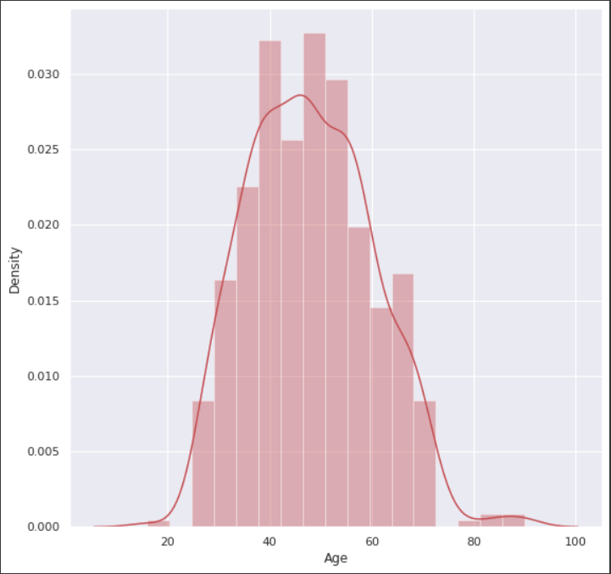
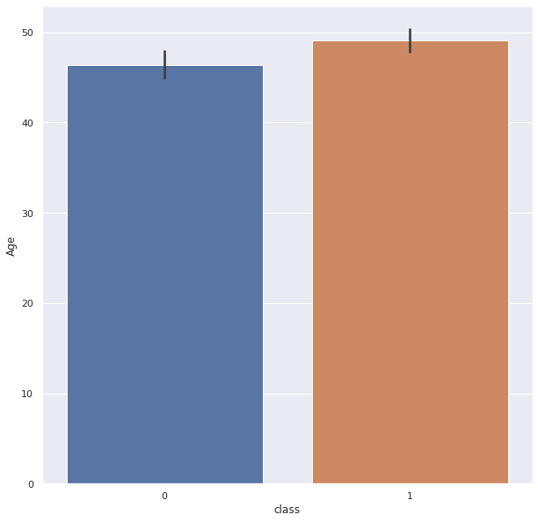
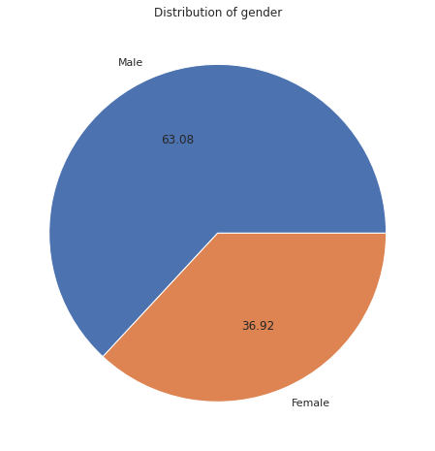
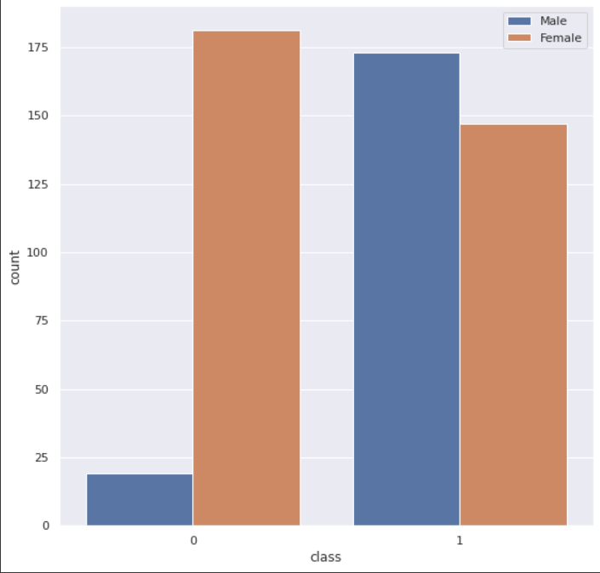
Project analysis slide 3
Characteristics of
Diabetes Dataset
This project is a Binary classification problem., where the model has to predict “positive”
Or “negative”, by relating the outcome variable with the different symptoms.
63.08 %
Negative
Positive
Age Distribution
Diabetic person as per
Age group
36.92 %
Negative
Positive
Percentage of male
And female
Gender Distribution

Slide 4
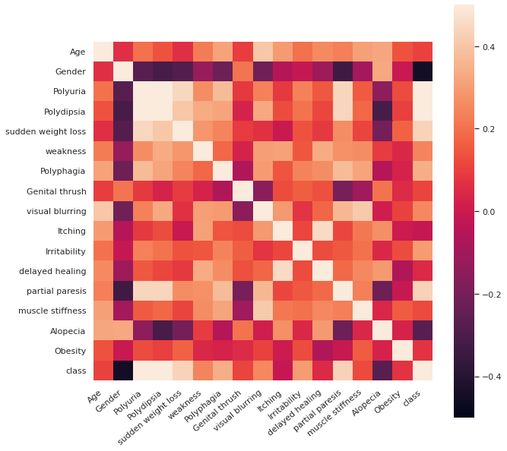
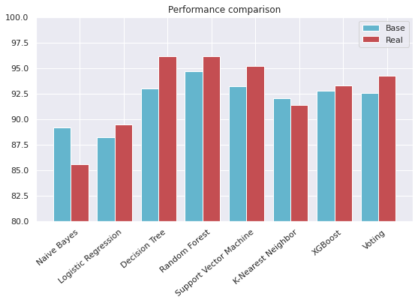
Project analysis slide 4
Characteristics of
Model
This is the Correlation of different features with the outcome variable i.e. the
class feature variable in the dataset
More lighter the section is, more is the correlation
See this row, the class has high correlation with “Polyuria”, “Polydipsia”
The next highest correlation is “Sudden weight loss”, “partial paresis”
This is the final performance comparison of different ML algorithms for classification problem
Used algorithms are given such as: Naïve Bayes, Logistic Regression, KNN, etc.
As per the comparison plot, Almost every algorithm has 80% + accuracy
“Decision Tree”, “Random Forest” holds the highest amount of accuracy of 96.1% accuracy

Slide 5
Thank You

